Slide 1
Microprocessors
CSE – 305
Lecture 8
Course Teacher: Dr. Israt Jahan

Slide 2
INTERRUPT
The meaning of ‘interrupts’ is to break the sequence of operation. While the cpu is executing a program,on ‘interrupt’ breaks the normal sequence of execution of instructions, diverts its execution to some other program called Interrupt Service Routine (ISR) which does the necessary work to handle interrupt. After executing ISR , the control is transferred back again to the interrupted program.
That means that an interrupted program does not realize that it was interrupted except that its execution is slowed down.

Slide 3
Interrupt
Main Program
Interrupt Service Routine

Slide 4
Interrupts
An interrupt is an event that occurs while the processor is executing a program
The interrupt temporarily suspends execution of the program and switch the
processor to executing a special routine (interrupt service routine)
When the execution of interrupt service routine is complete, the processor
resumes the execution of the original program
Interrupt classification
Hardware Interrupts | Software Interrupts
Caused by activating the processor’s interrupt control signals (NMI, INTR) | Caused by the execution of an INT instruction Caused by an event which is generated by the execution of a program, such as division by zero

Slide 5
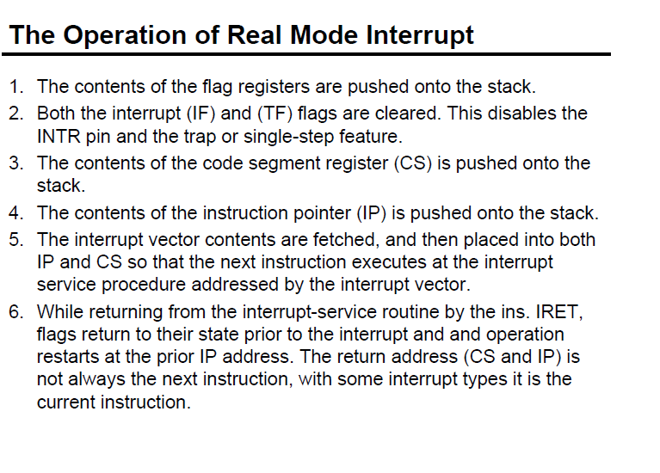

Slide 6
When a system is instructed to single-step, it will execute one instruction and then stop. The contents of registers and memory locations can be examined; if they are correct, the system can be told to go on and execute the next instruction. The Intel 8086 trap flag and type-1 interrupt response make it quite easy to implement a single-step feature in an 8086-based system. If the trap flag is set, the 8086 will automatically do a type-1 interrupt after each instruction executes. When the 8086 does a type-1 interrupt, it pushes the flag register on the stack.

Slide 7
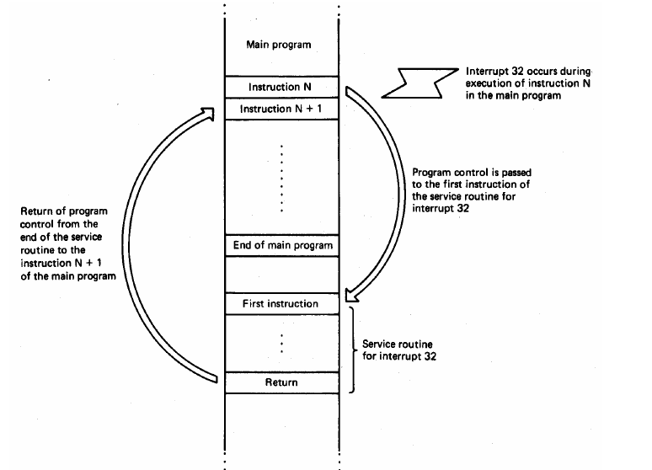

Slide 8
Interrupt Sources
Hardware Interrupts (External Interrupts)
ex: NMI, INTR
Software Interrupts (Internal Interrupts and Instructions)
ex: INT n (Software Instructions)

Slide 9
HARDWARE INTERRUPT
An interrupt caused by applying the signal to NMI and INTR pins are called hardware
Interrupts. The microprocessor responds to the INTR input by pulsing the INTA output.
SOFTWARE INTERRUPT
The 8086 has some software interrupts.
These interrupts are caused by INT instruction .
Some software interrupts are caused by conditions by conditions produced in
the 8086 by the execution on instructions.
An example is divide by zero interrupt.

Slide 10
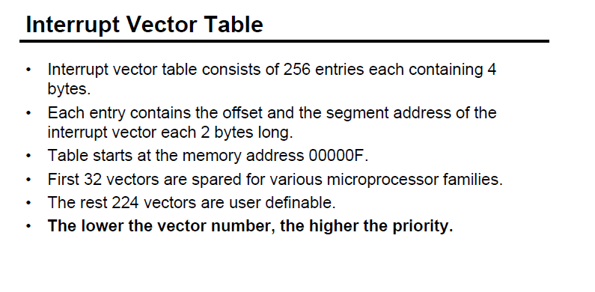

Slide 11
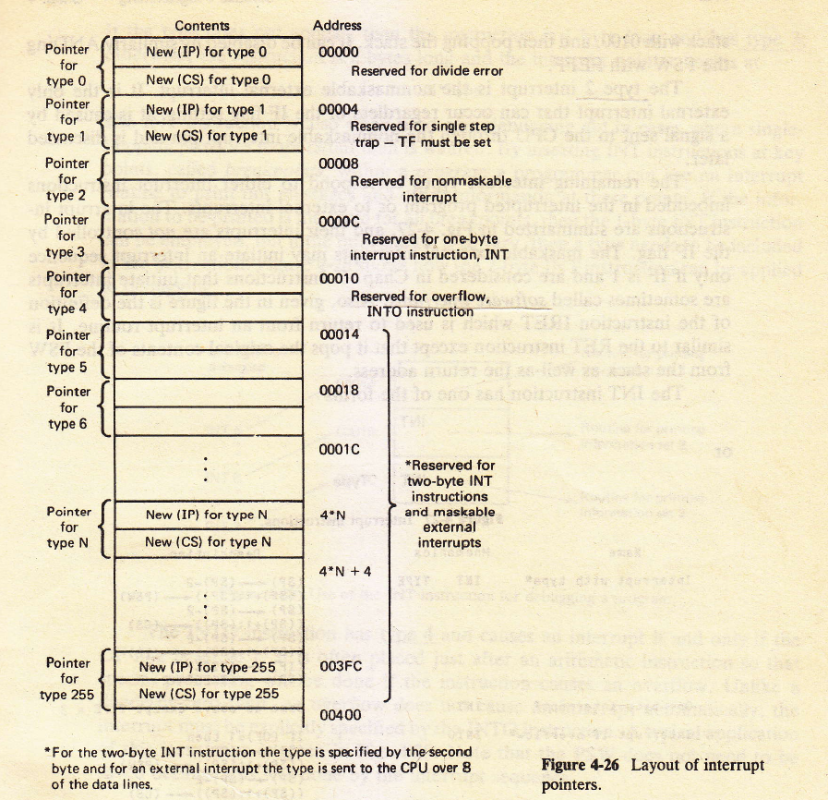

Slide 12
Interrupt Vector Table
INT Number Physical Address
INT 00 00000
INT 01 00004
INT 02 00008
: :
: :
INT FF 003FC

Slide 13
Example
Find the physical address in the interrupt vector table associated with
INT 12H b) INT 8H
Solution: a) 12H * 4 = 48H
Physical Address: 00048H ( 48 through 4BH are set aside for CS & IP)
b) 8 * 4 = 20H
Memory Address : 00020H

Slide 14
Interrupt Pointer
An interrupt pointer or interrupt vector contains the starting address (segment and offset) of the interrupt service procedure.
The first 1 KB of memory from 00000H to 003FFH contains 256 different interrupt vectors.

Slide 15
Function of dedicated interrupt in the microprocessor
Type 0 | Divide by error occurs whenever the result of a division overflows or whenever an attempt is made to divide by zero
Type 1 | Single-Step or Trap occurs after the execution of each instruction if the trap flag(TF) is set. Upon accepting this interrupt, the TF bit is cleared. So that the interrupt service procedure executes at full speed.
Type 2 | Non-maskable Hardware Interrupt- A result of placing a logic 1 on the NMI input pin to the microprocessor. This input is non-maskable, which means that it cannot be disabled.
Type 4 | Overflow- A special vector used with the INT0 instruction. The INT0 instruction interrupts the program if an overflow condition exists, as reflected by the overflow flag.

Slide 16
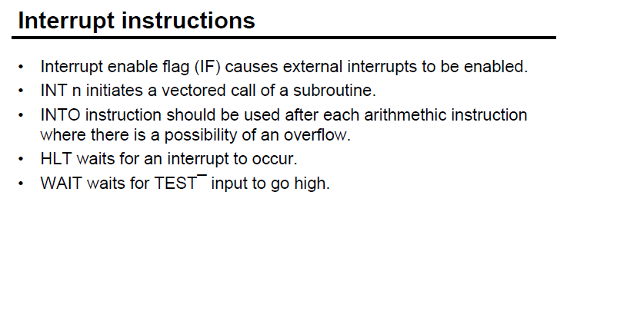

Slide 17
